Slide 1
Data Analysis of Payor Payments
Key Insights and Visualizations
-Monalisa Swami

Slide 2
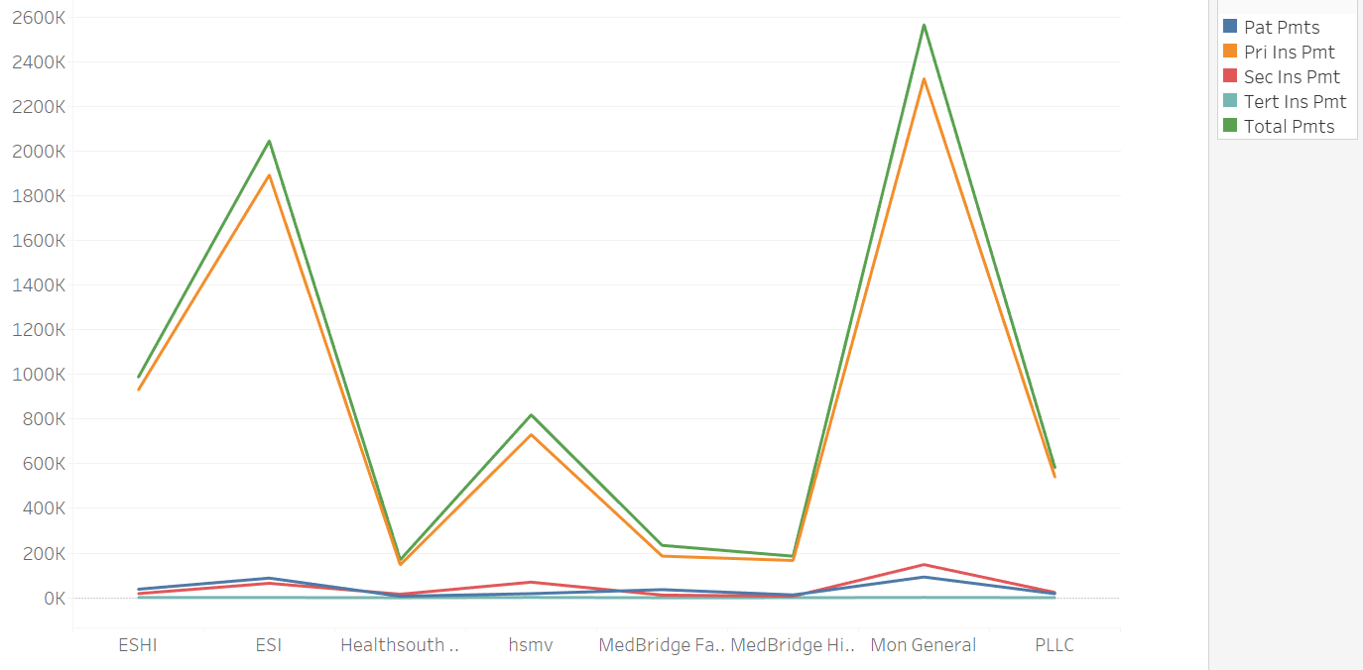
Variation in Payments by Payors

Slide 3
Key Insights
Highest Payment Amounts
Highest Payment Share
Lowest Payments Tier
Mon Health Medical Center has very high cumulative total and primary insurance payments as compared to the other facilities, at about 2.5M and 2.3M respectively. It is followed by ESI and HSMV.
Primary insurance payments make up the highest share of the total payments, at more than 90%, for all facilities, whereas tertiary is consistently the lowest.
Medbridge Highlands, Medbridge Fairmont and Healthsouth have significantly low payment amounts as compared to the rest.

Slide 4
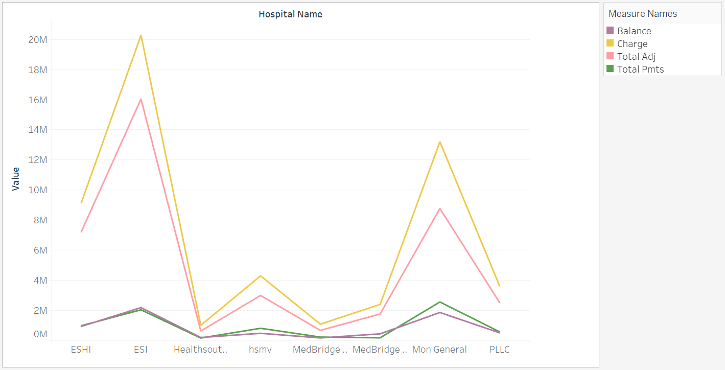
ESI has the highest cumulative charge in 2019, followed by Mon General.
Healthsouth and Medbridge Fairmont have the lowest charges as compared to other facilities.
ESI is the only facility with cumulative balance greater than the total payment.

Slide 5
Notable CPT Insights
Emergency Department Visits
Highest cumulative charges at ESHI at $7.4M and ESI at $16.3M
Subsequent Hospital Care
Highest cumulative charges at Mon General at $5.2M and $790.7k at Healthsouth UHC
Initial Hospital Care
Highest cumulative charges at PLLC at $1.7M and Medbridge Highlands at $1.2M
Constant charges
Majority of the CPT codes display a flat, constant curve with respect to the charges and other payment amounts such as adjustments and balances.

Slide 6

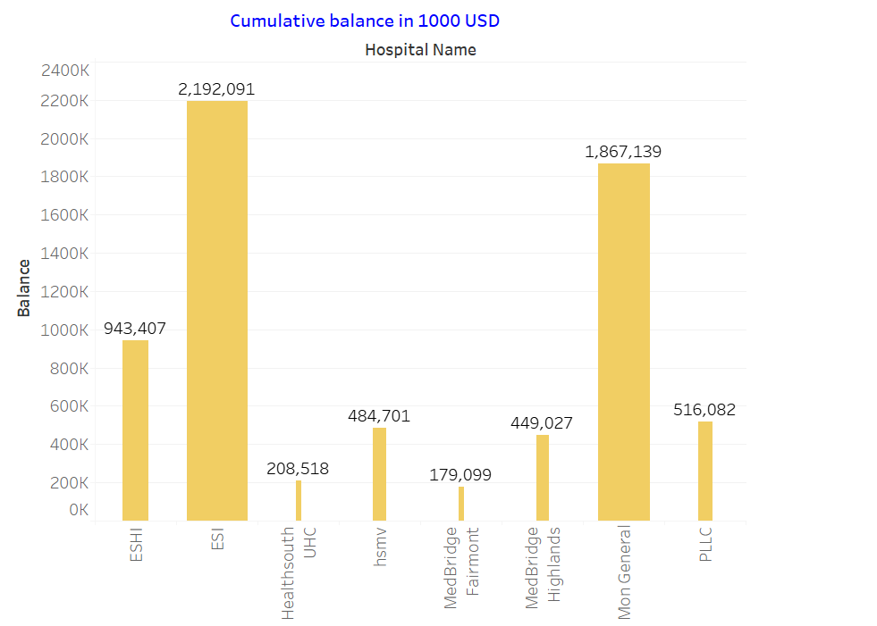
Miscellaneous Overall Insights - Year 2019
Doctor with the maximum service entries: Bharti, MD S with 26,094 records
CPT code with highest entries: CPT 99233 (Subsequent Hospital Care) with 16,247 records.
Highest cumulative payment recorded for other chest pain: $327,797

